Slide 1
SUS Performance Funding
Institute for Academic Leadership
Joe Glover
October 2015

Slide 2
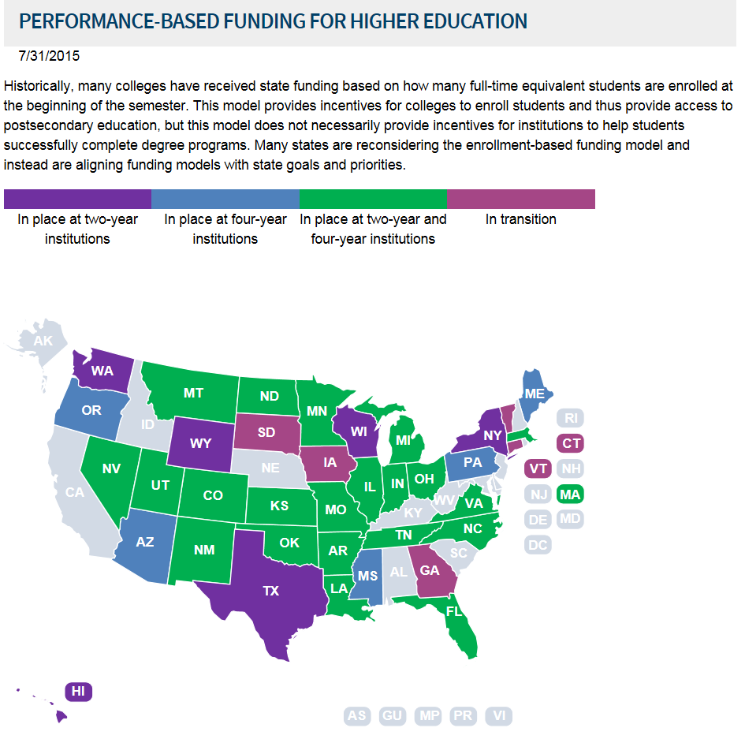

Slide 3
The Performance Funding Model includes 10 metrics that evaluate the institutions on a range of issues. Two of the 10 metrics are Choice metrics; one picked by the Board and one by the university boards of trustees. These metrics were chosen after reviewing over 40 metrics identified in the University Work Plans.
The model has four guiding principles: 1) use metrics that align with SUS Strategic Plan goals, 2) reward Excellence or Improvement, 3) have a few clear, simple metrics, and 4) acknowledge the unique mission of the different institutions.
Key components of the model:
Institutions will be evaluated on either Excellence or Improvement for each metric.
Data is based on one-year data.
The benchmarks for Excellence were based on the Board of Governors 2025 System Strategic Plan goals and analysis of relevant data trends, whereas the benchmarks for Improvement were determined after reviewing data trends for each metric.
The Florida Legislature and Governor determine the amount of new state funding and a proportional amount of institutional funding that would come from each university’s recurring state base appropriation.

Slide 4
Metrics Common to all Institutions:
Seven metrics apply to all eleven institutions. The eighth metric, graduate degrees awarded in areas of strategic emphasis (8a), applies to all institutions except New College. The alternative metric for New College (8b) is “freshman in the top 10% of graduating high school class.”

Slide 5
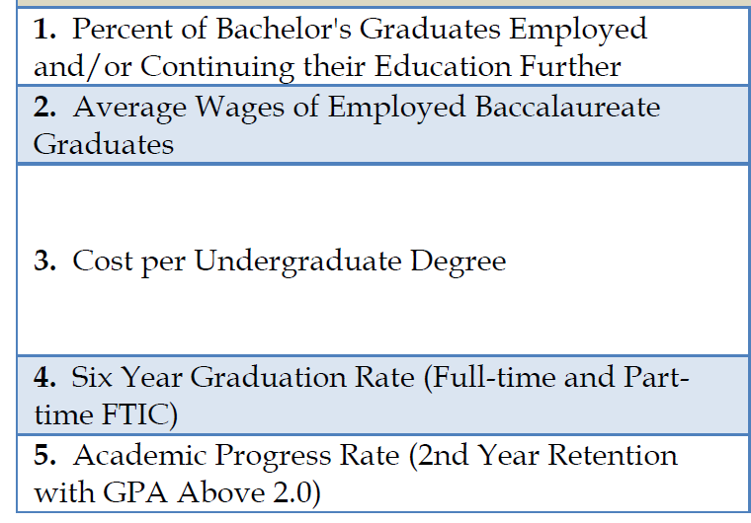

Slide 6
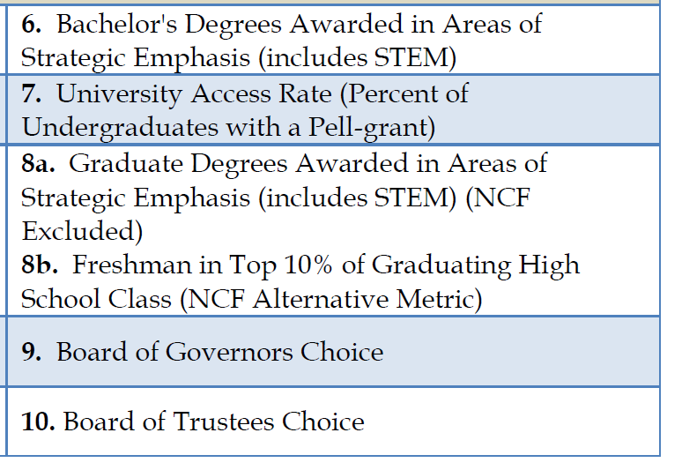

Slide 7
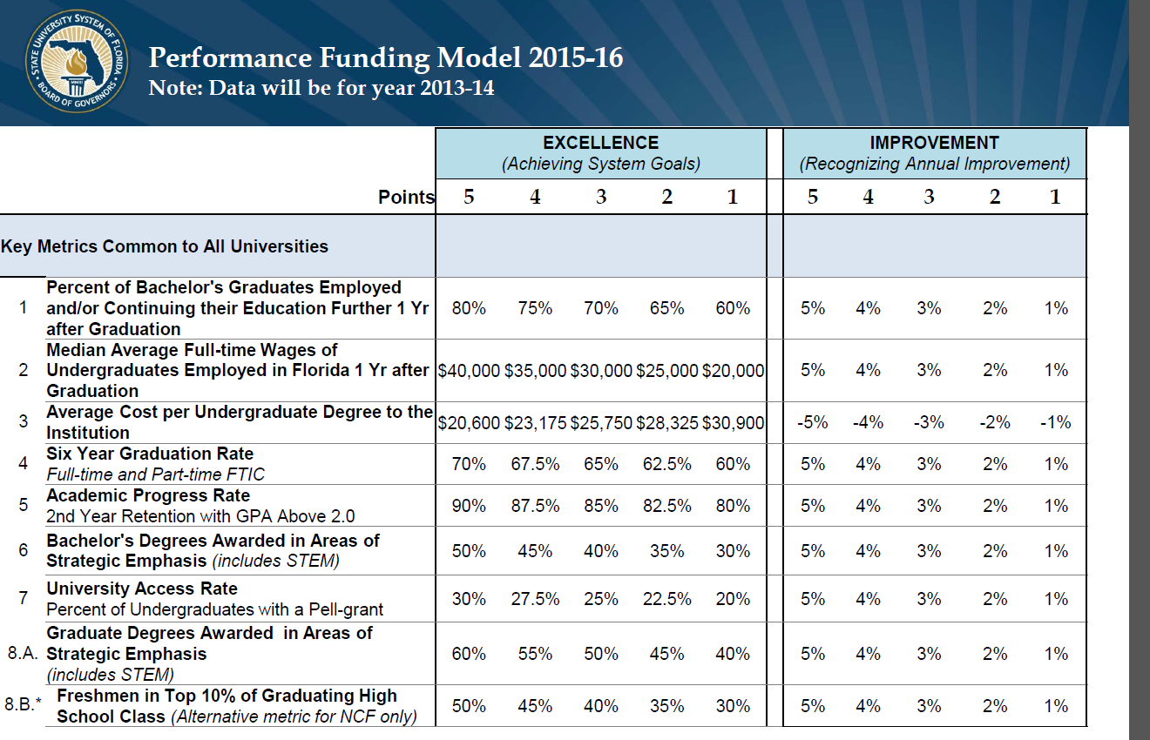

Slide 8
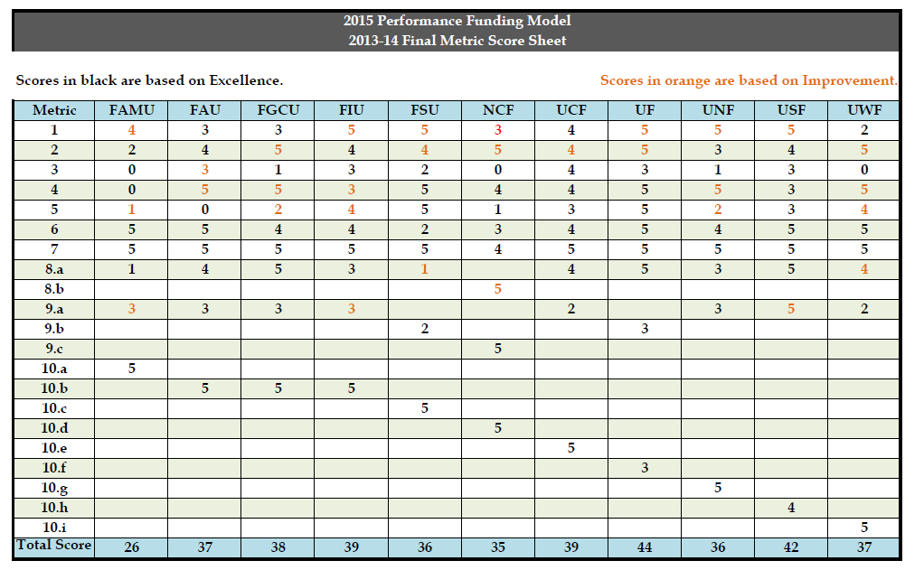

Slide 9
2015 Performance Funding Model
2013-14 Final Metric Score Sheet
Metric 1 - Percent of Bachelor's Graduates Employed and/or Continuing their
Education Further 1 Yr after Graduation
Metric 2 - Median Average Wages of Undergraduates Employed in Florida 1 Yr after
Graduation
Metric 3 - Average Cost per Undergraduate Degree to the Institution
Metric 4 - Six Year Graduation Rates (Full-time and Part-time FTIC)
Metric 5 - Academic Progress Rate (2nd Year Retention with GPA above 2.0)
Metric 6 - Bachelor's Degrees Awarded in Areas of Strategic Emphasis (includes STEM)
Metric 7 - University Access Rate (Percent of Undergraduates with a Pell Grant)
Metric 8a - Graduate Degrees Awarded in Areas of Strategic Emphasis (includes STEM)
Metric 8b - Freshman in Top 10% of Graduating High School Class
Metric 9 - Board of Governors' Choice (see detailed sheets)
Metric 10 - Board of Trustees' Choice (see detailed sheets)

Slide 10
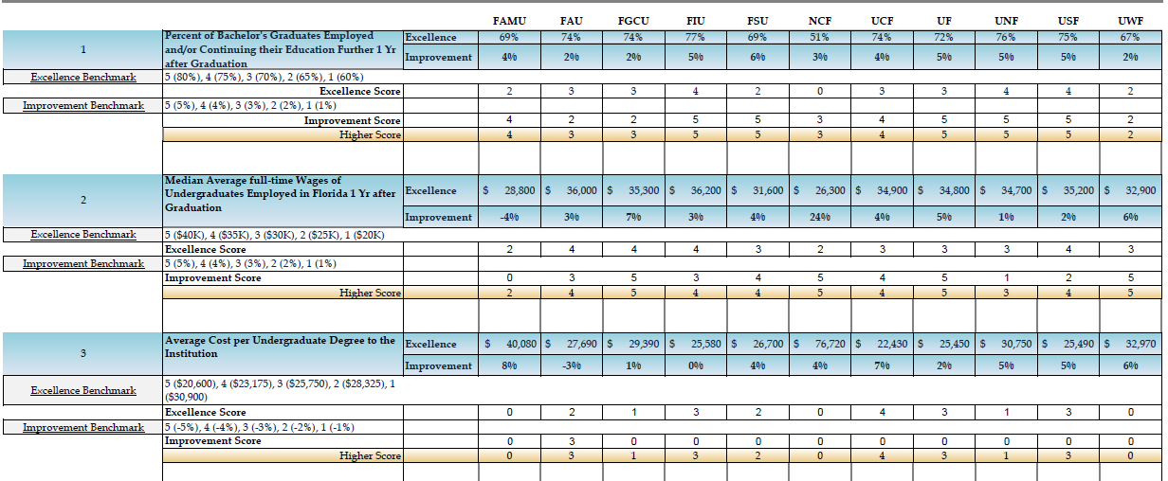

Slide 11
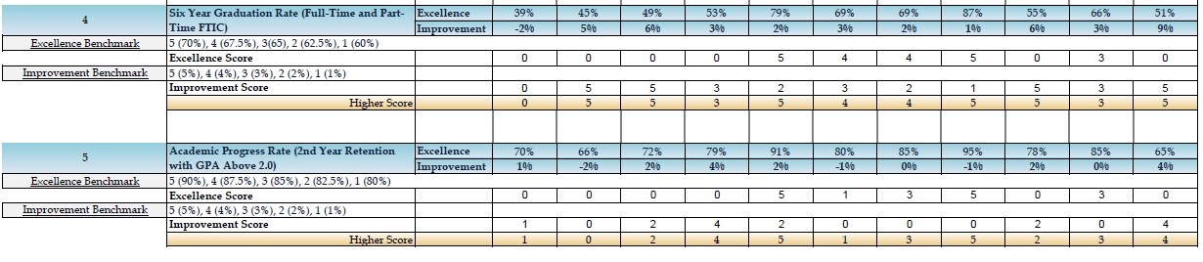

Slide 12
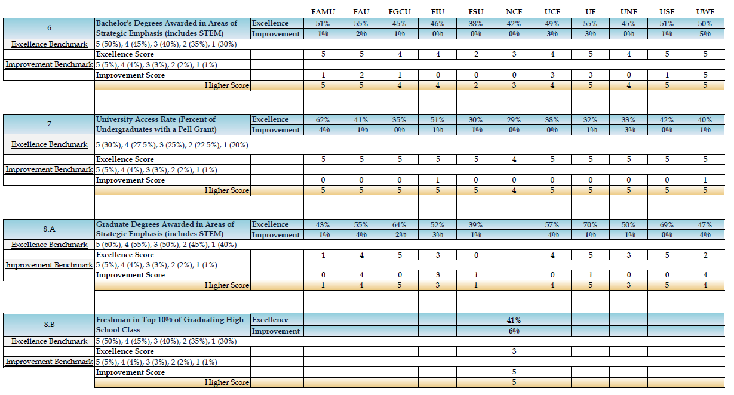

Slide 13
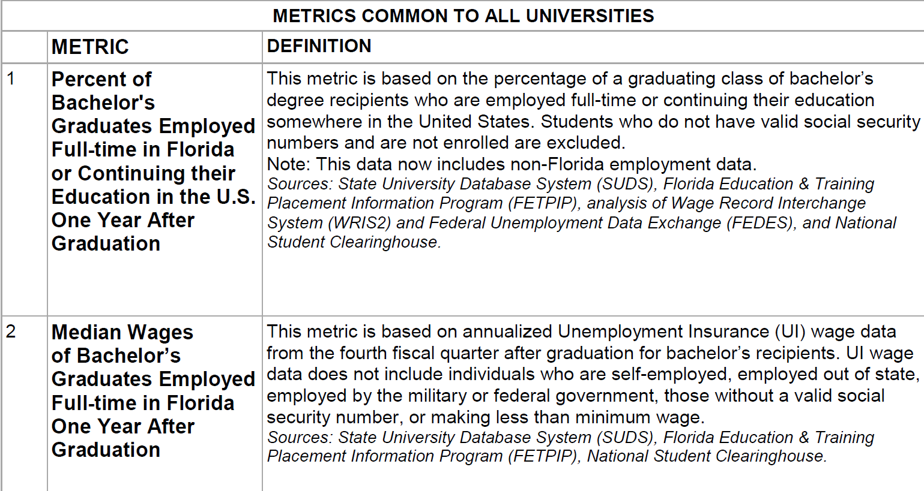

Slide 14
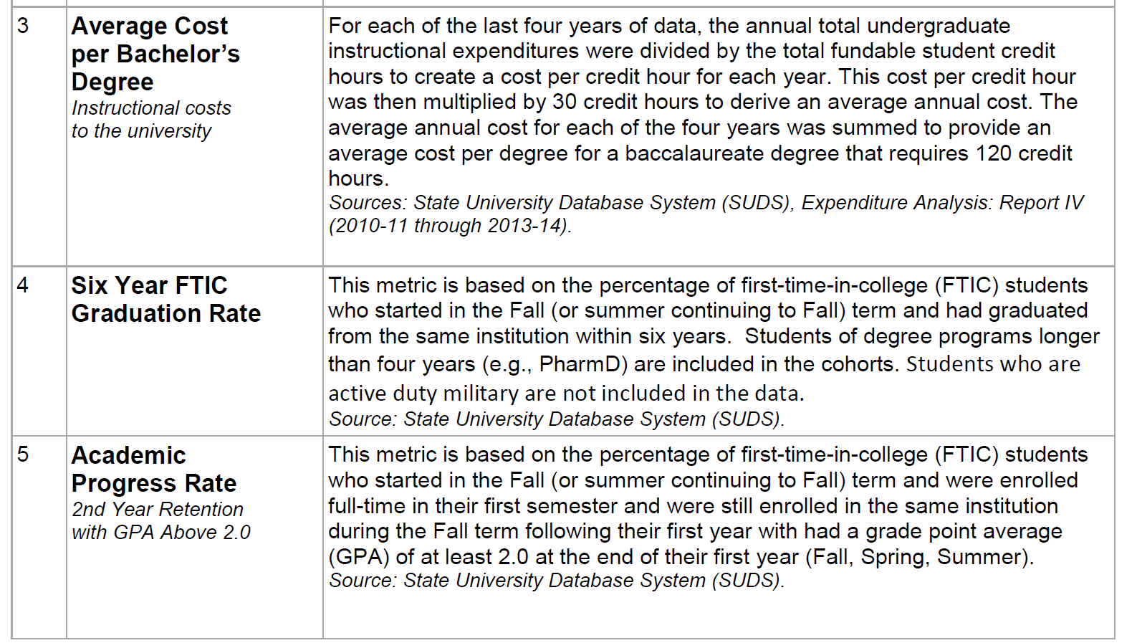

Slide 15
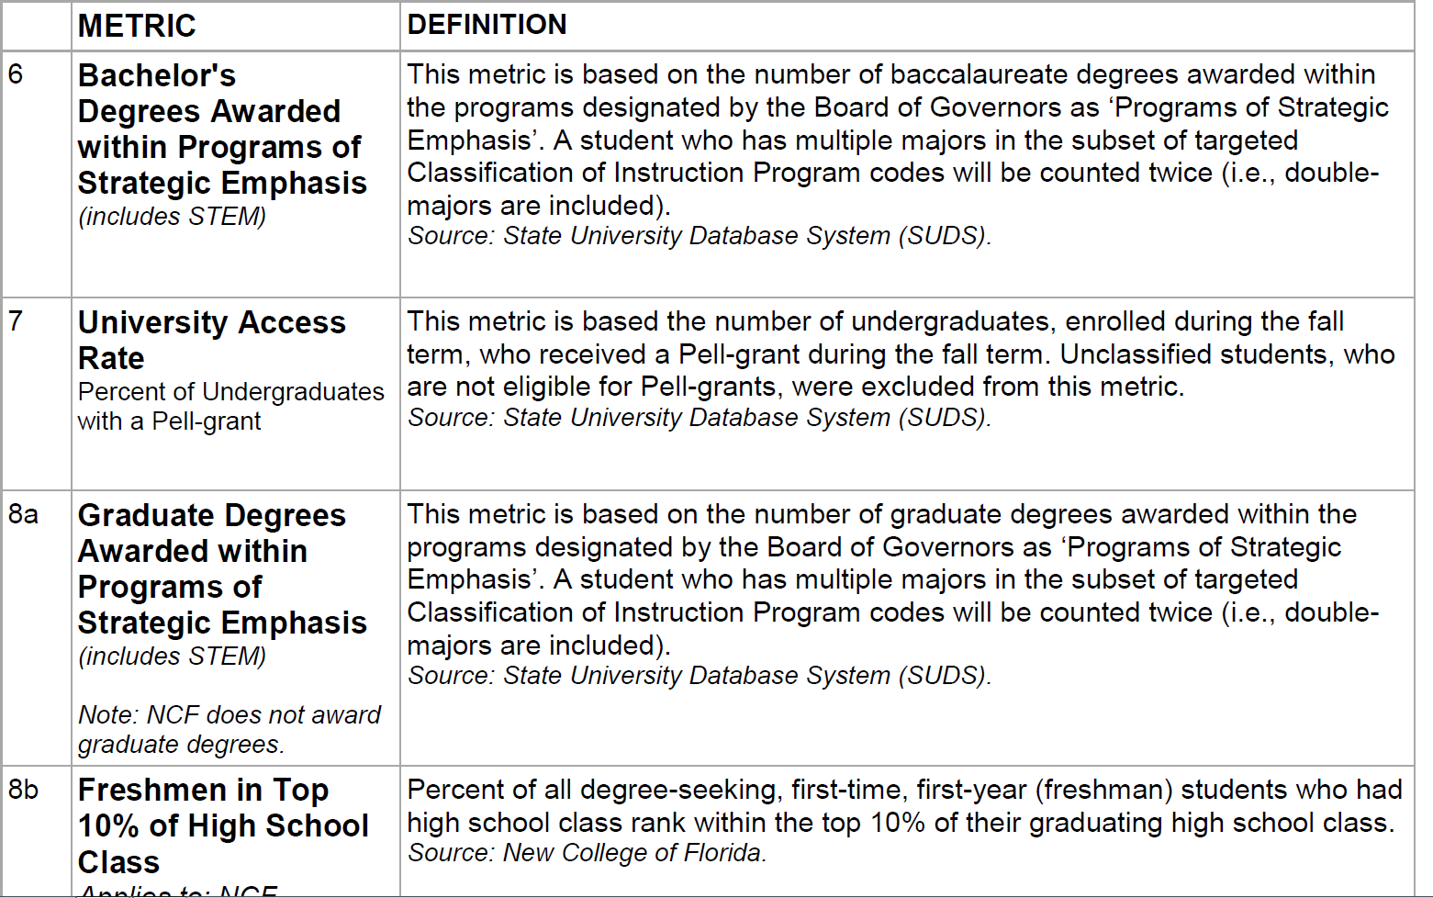

Slide 16

How will the funding component of the model work?
To ensure each university is striving to excel and improve on key metrics, there must be a financial incentive. That financial incentive will not only be new state funding, but an equal reallocation of a portion of the base state funding.

Slide 17
New Funding versus Base Funding:
The amount of new state funding appropriated by the Legislature and Governor for performance funding will be matched by an equal amount reallocated from the university system base budget. These “base” funds are the cumulative recurring state appropriations the Legislature has appropriated to each institution. Any new funding appropriated would be allocated as follows:
State New Funding Allocation
Each university metric is evaluated based on Excellence or Improvement and has five benchmarks ranging from low to high. The lowest benchmark receives one point, while the highest receives five points. The highest points for Excellence or Improvement are counted in the university’s total score.
New funding will be allocated based on points earned, with a maximum of 50 points possible.
A university must earn more than 25 points in order to be eligible to receive new funds.
A university scoring 25 points or less or the three lowest scoring universities would not receive any new funds.
A university earning more than 25 points would receive new funds proportional to their existing base funds with the highest scoring universities eligible for additional new funds.
The Board’s practice is to address all ties to the benefit, not the detriment, of the institutions in question. No matter where the tie takes place in the score rankings, the practice is the same.

Slide 18

Institutional Base Funding Allocation
A prorated amount would be deducted from each university’s base recurring state appropriation.
A university earning more than 25 points will have their base funding restored.
A university scoring 25 points or less will have to submit an improvement plan to the Board of Governors and show improvement according to that approved plan in order to have their base funding restored.

Slide 19
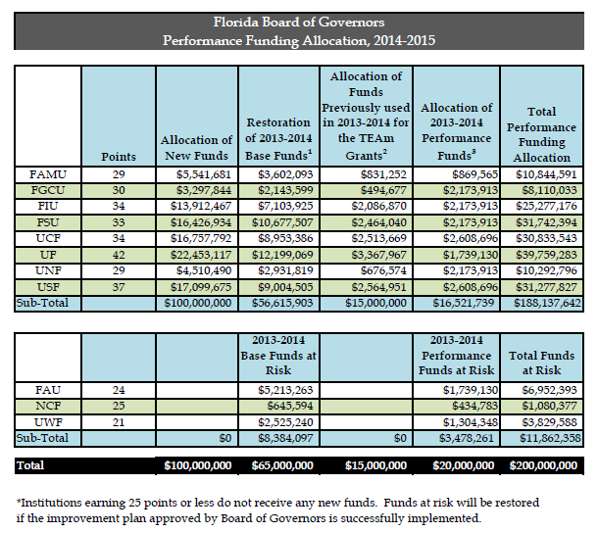

Slide 20

Notes:
¹ Each university contributed a portion of their base budget, for a total of $65 million, to be allocated based on performance. Universities that had 26 points or higher receive their full base funding restored. Universities with 25 points or less have to submit an improvement plan to be approved by the Board of Governors. Restoration of their base funding is contingent upon successful implementation of the improvement plan.
² In 2013-2014, $15 million was provided to the Board to provide grants to address targeted program areas as identified in the GAP Analysis Report prepared by the Commission on Florida Higher Education Access & Attainment. These funds are reallocated in 2014-2015 pursuant to the Board's performance model.
³ In 2013-2014, $20 million was provided for performance funding to be allocated based on 3 metrics identified in legislation. These funds are reallocated pursuant to the Board's approved methodology adopted in November, 2013. However, universities that scored 25 points or less on the Board's performance model will only receive these funds upon successful implementation of the improvement plan.

Slide 21
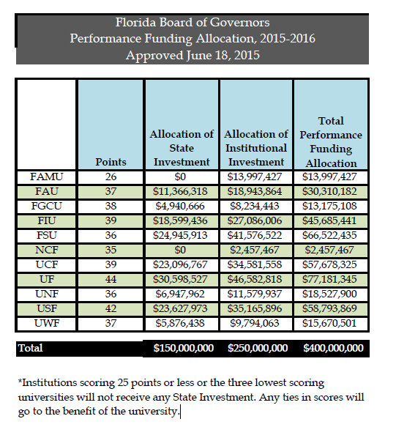

Slide 22
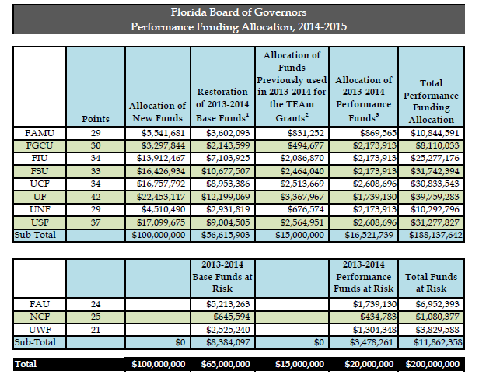

Slide 23

SUBJECT: Performance Based Funding Model Revision of Board of Trustees Benchmarks in Anticipation of Change to 100 Point Scale
DUE: October 28, 2015
Discussion was held at the September 22, 2015 Budget and Finance Committee on the possibility of moving to a 100 point model, instead of the 50 point model. A final determination will be made at the November meeting.
In anticipation of the Board moving in this direction, we would request each university to take this opportunity to revise their benchmarks for Board of Trustees Choice Metric #10 (copy attached). Please pay attention to the following issues as you consider this change:
• The metric should stay the same unless moving to this revised benchmark with a 10-point scale creates a logistical problem with the metric.
• Revised benchmarks should be evenly spaced from 10 points (highest score) to 1 point (lowest score) for that metric.
• Remember that one of the Board’s guiding principles is to have clear, simple metrics. Therefore, do not submit compound benchmarks that require an additional level of analysis, for example, benchmarks that require analysis of performance against a list of competitor institutions and then grading across a point scale.
These revised benchmarks will only be utilized if the change to a 100-point scale is approved at the November Board Meeting.

Slide 24
